Slide 1
Container lifecycle
ow

Slide 2
definition
Docker is a containerization platform that enables the development, deployment, and execution of applications inside containers.
Multiple containers can run simultaneously on a single host.
Containers are lightweight and start quickly because, unlike virtual machines, they do not rely on a hypervisor. Instead, they run directly on the host machine’s kernel.

Slide 3
..
The Docker Container Lifecycle describes the various stages that occur when we create a Docker container. Among the states are:
Created: A container that has been created but not started
Running: A container running with all its processes
Paused: A container whose processes have been paused
Stopped: A container whose processes have been stopped
Deleted: A container in a dead state

Slide 4
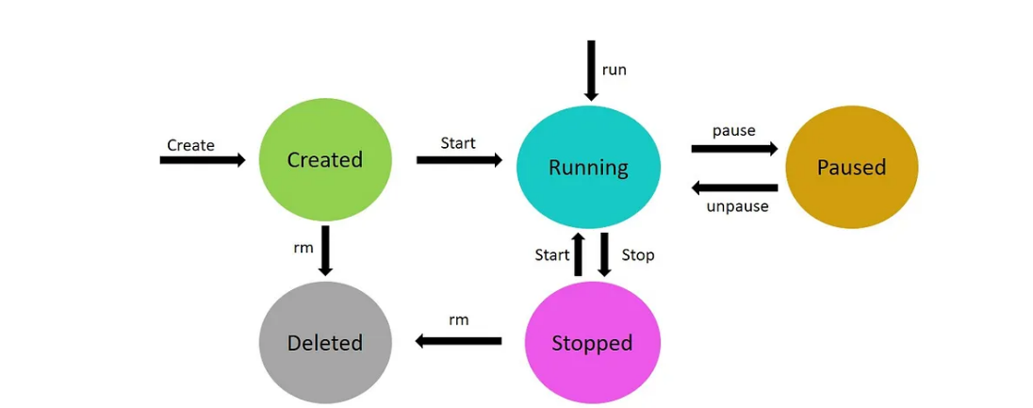
.

Slide 5
states
Created state : In the created state, a docker container is created from a docker image.
docker create --name <name-of-container> <docker-image-name>
Running state ;When the docker container is running, it begins executing the commands shown in the image. The docker run command is used to start a docker container.
docker run <container-id>
or
docker run <container-name>

Slide 6
..
Paused state : The current command in the docker container is paused when it is in the paused state. To pause a running container, use the docker pause command.
docker pause container <container-id or container-name>
Note: docker pause pauses all the processes in the container. It sends the SIGSTOP signal to pause the processes in the container.
Unpaused state : When the container is unpaused, it resumes executing the commands that were paused. Then, Docker sends the SIGCONT signal to resume the process.
docker unpause <container-id or container-name>

Slide 7
..
Stopped state The container’s main process is gracefully shutdown in the stopped state. Docker sends SIGTERM for graceful shutdown and SIGKILL to kill the container’s main process if necessary. To stop a container, use the docker stop command.
docker stop <container-id or container-name>
Restarting a docker container would result in a docker stop followed by a docker run, i.e., stop and run phases.
Killed/Deleted state :The container’s main processes are terminated abruptly in the killed state. Docker sends a SIGKILL signal to the container’s main process to terminate it.
docker kill <container-id or container-name>

Slide 8
Start,run,create
The Docker create command creates a new container based on the image specified. However, the container will not be started immediately.
The Docker start command is used to restart any previously stopped container. If we used docker to create a container command, then we can start it with this command.
Docker run is a combination of create and start because it creates a new container and immediately starts it. In fact, if the mentioned image is not found on your system, the docker run command can even pull an image from Docker Hub.

Slide 9
Stop and pause
The docker pause command suspends all processes in the containers specified. When suspending a process, the SIGSTOP signal is traditionally used, which is visible to the process being suspended. Furthermore, the memory portion would be present while the container is paused and used again when the container is resumed.
When we use the docker stop command, the main process inside the container receives SIGTERM, followed by SIGKILL after some time. It will also release the memory used after the container has been stopped.

